Slide 1
Tasks
24
7
30
Essential Question
Questions
Notes
Summary
6

Slide 2
24
7
30
Date
Topic: Triangles and Quadrilaterals
EQ – What does the exterior angle in triangle add to?

Slide 3
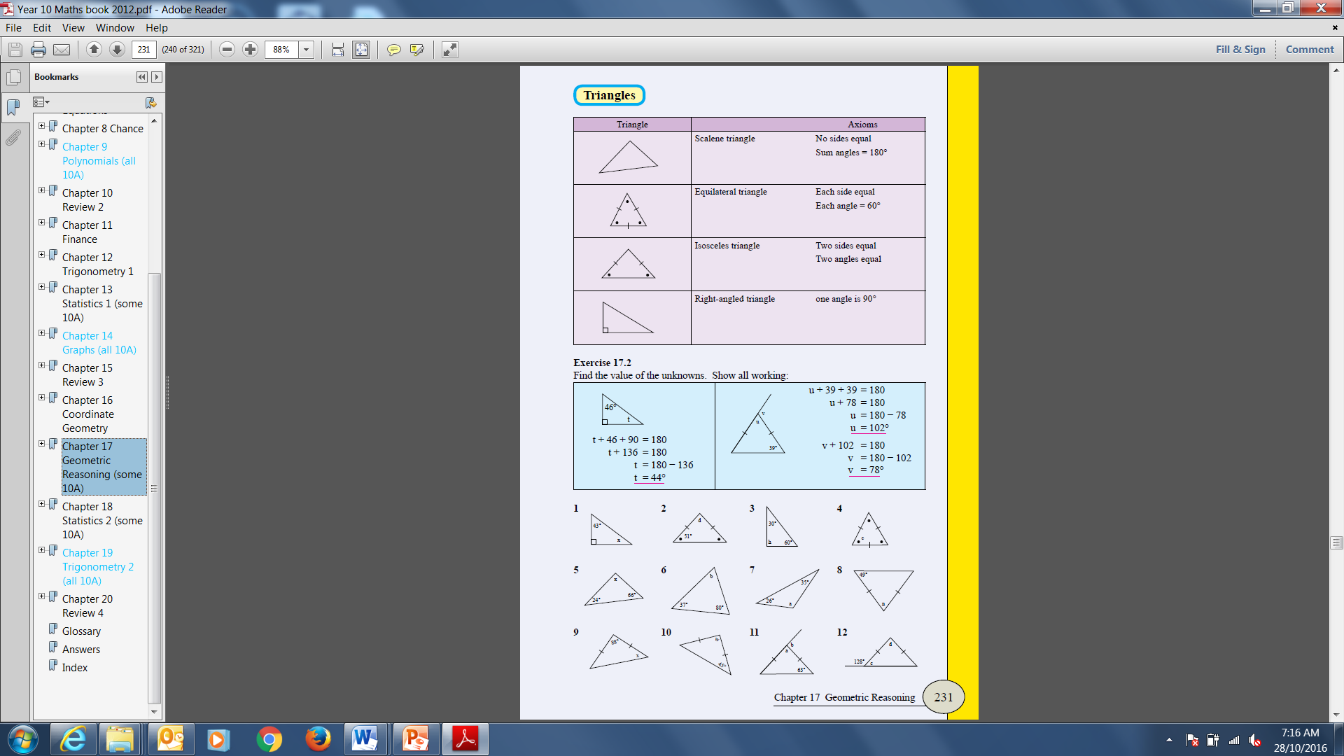

Slide 4
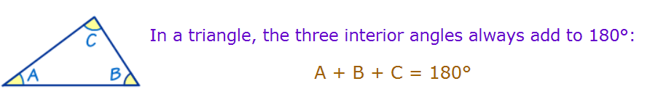
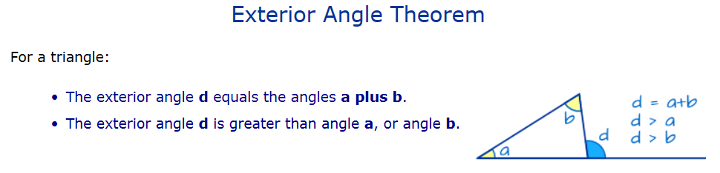
Exterior angle is equal to the sum of the two opposite interior angles.

Slide 5
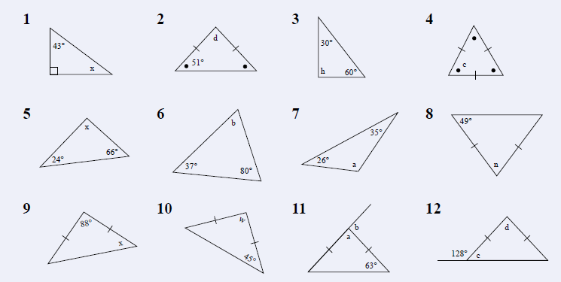

Slide 6
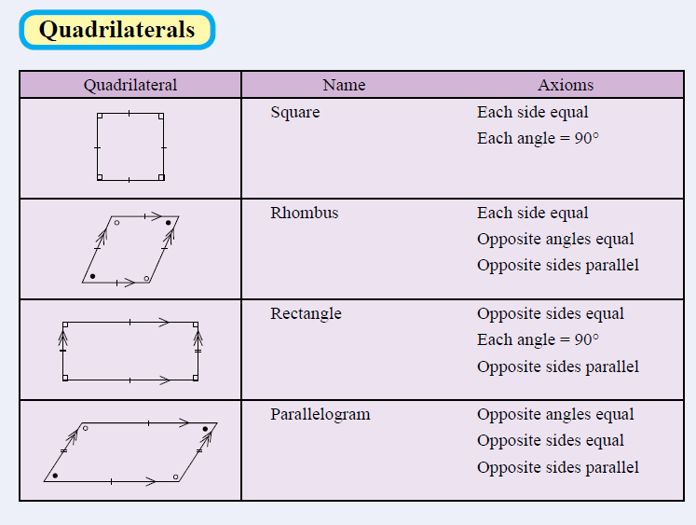

Slide 7
